Slide 1

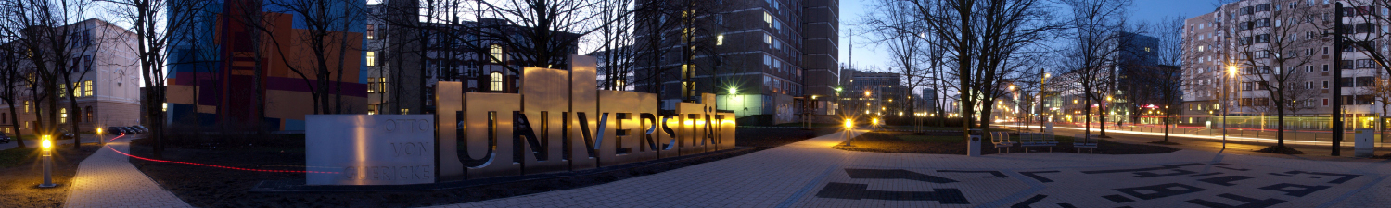
Robot Locomotion – An Introduction
Softwaredevelopment for Industrial Robotics
Marcel Grotzke, Gabriel Kögler, Henri Hamann

Slide 2
Structure of presentation
1 – Introduction to locomotion
2 – Core issues of locomotion
2.1 – legged locomotion
2.2 – wheeled locomotion
2.3 – comparision of locomotion mechanisms
3 – Outlook to locomotion research

Slide 3
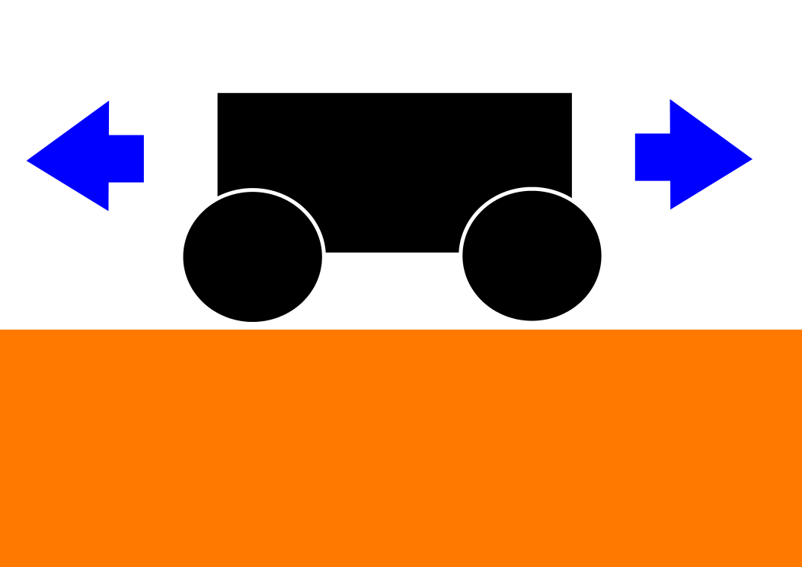
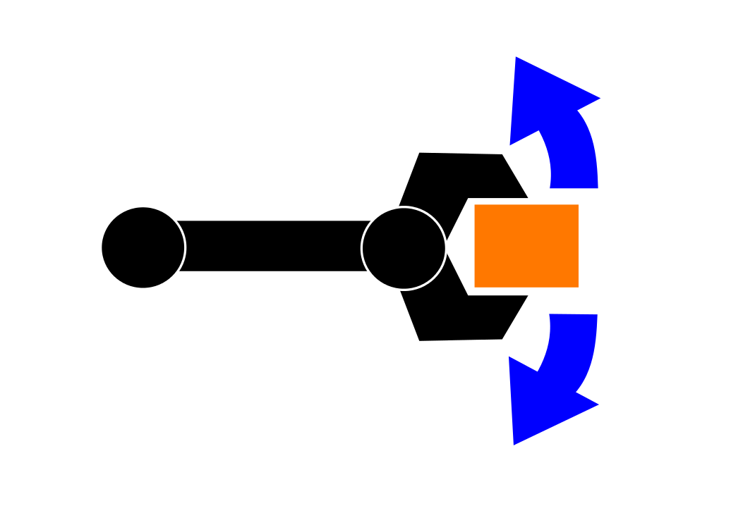
Introduction to locomotion
Locomotion
Environment fixed
Robot is moved
Manipulation
Robot fixed
Object is moved
Notes:
Both concepts
actuators
Generation of interaction forces
motors, pneumatics or hydraulics
Body extensions: arm <-> leg

Slide 4
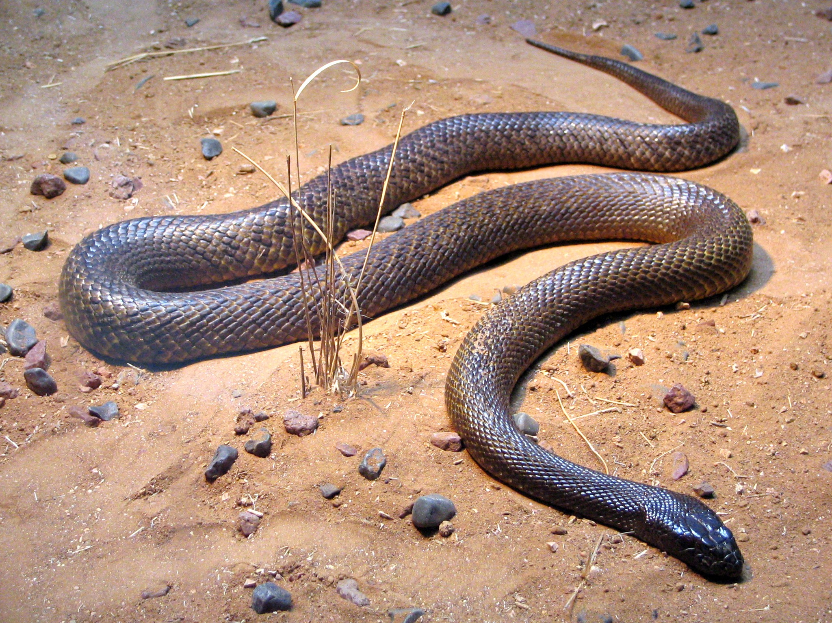

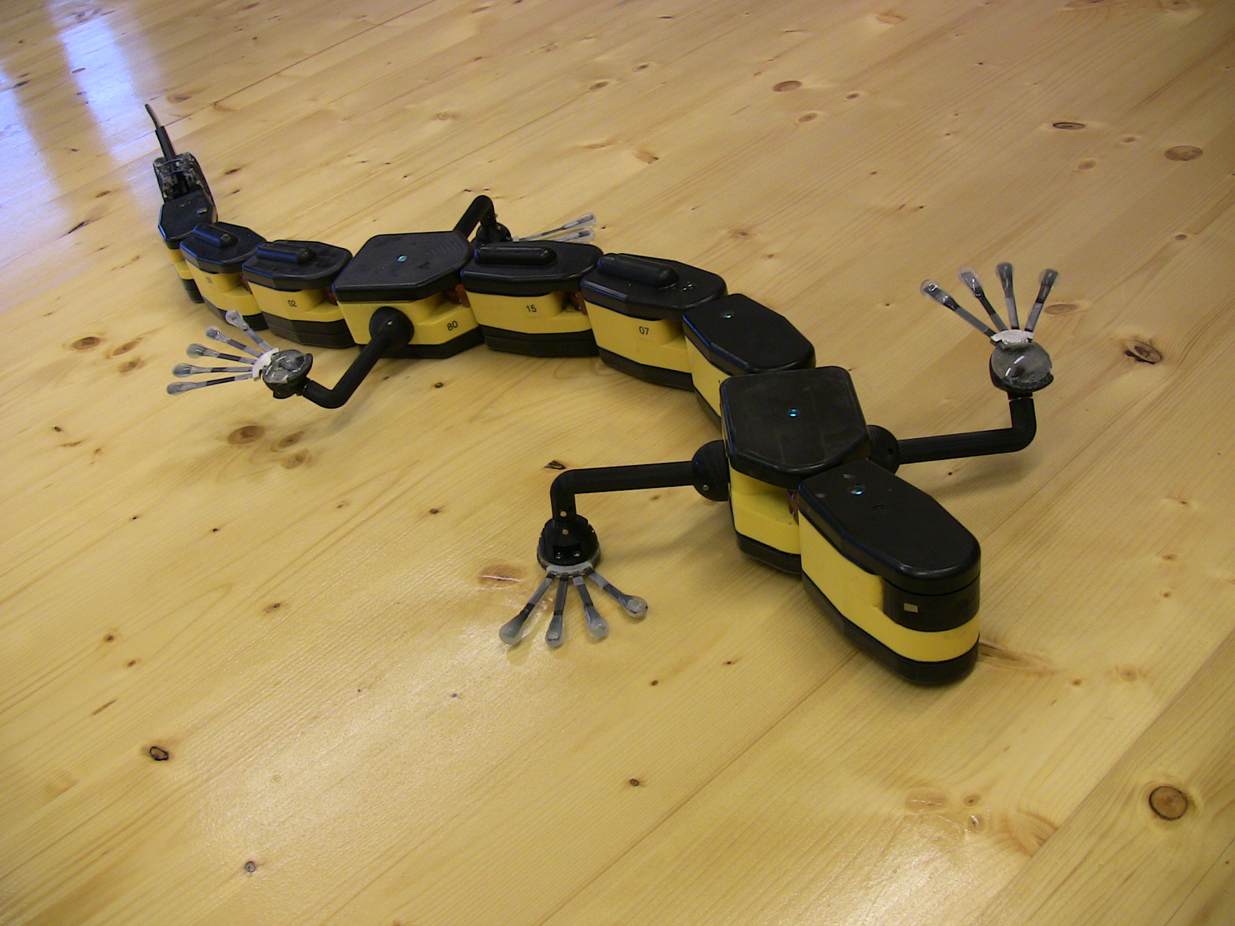
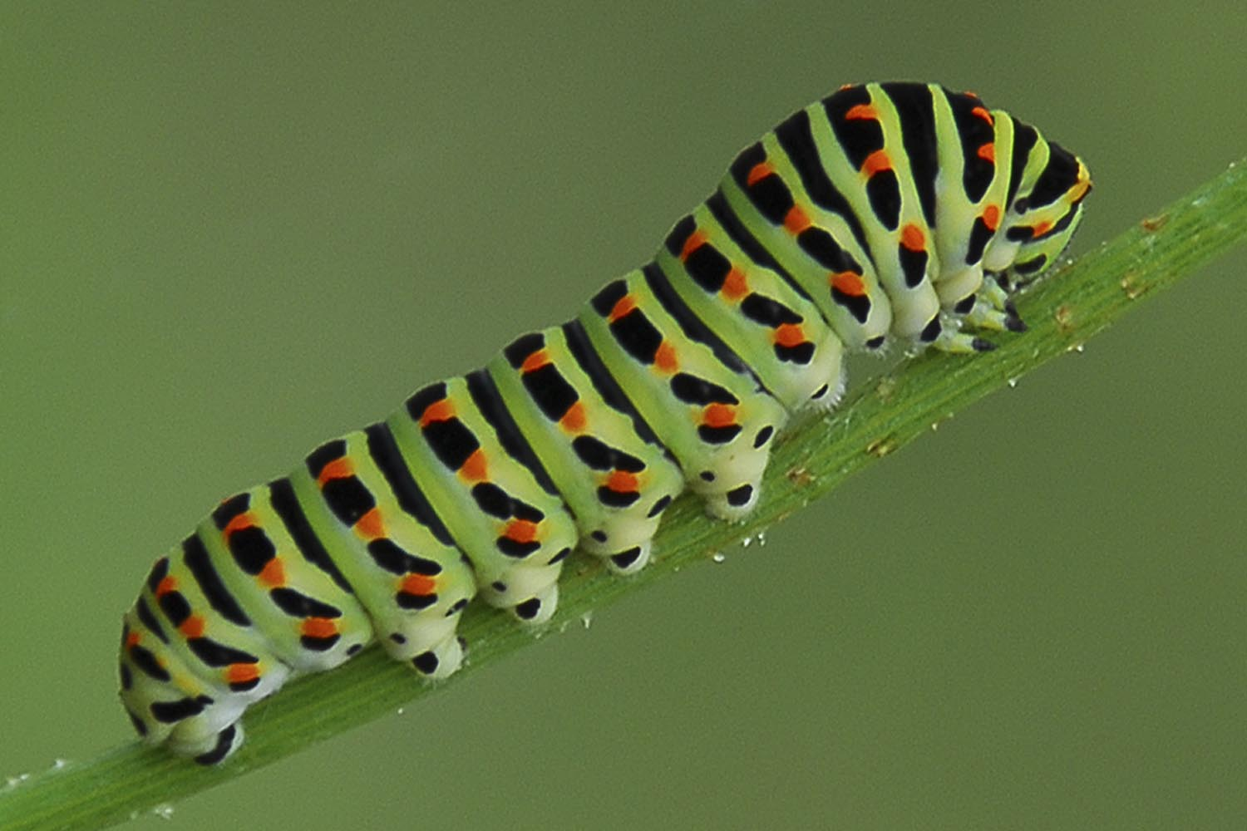
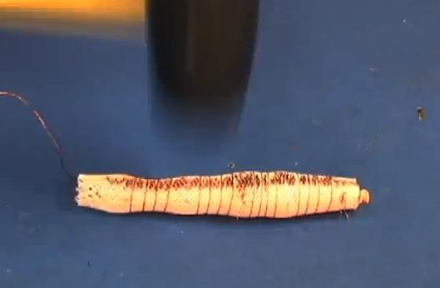
Introduction to locomotion
[B1]
[B2]
Salamandra
[B3]
[B4]
Meshworm
Notes:
sliding: can swim
Crawl: flexible metal wire -> robust

Slide 5
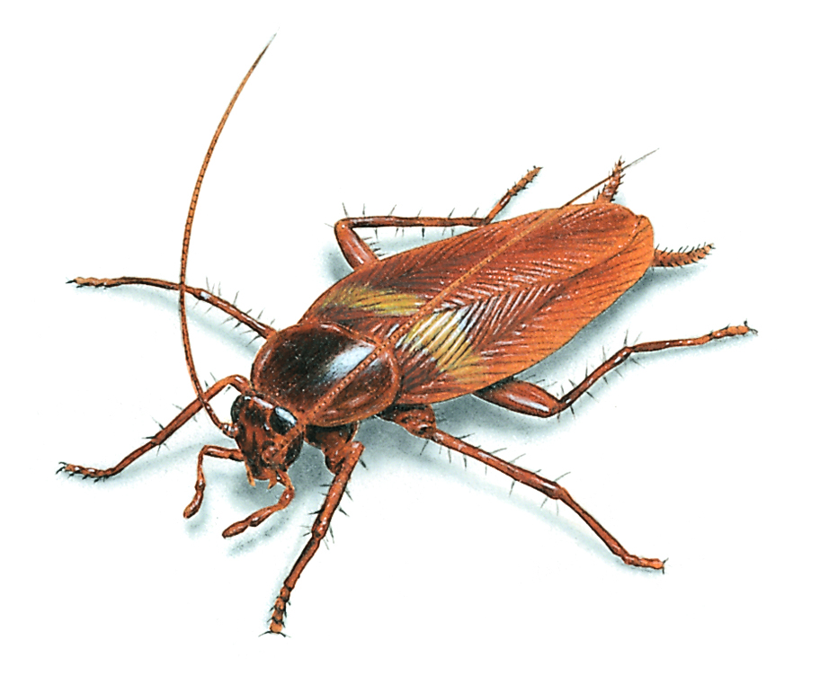
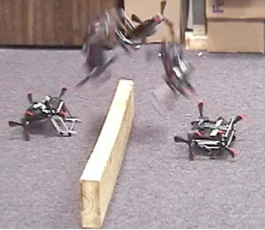
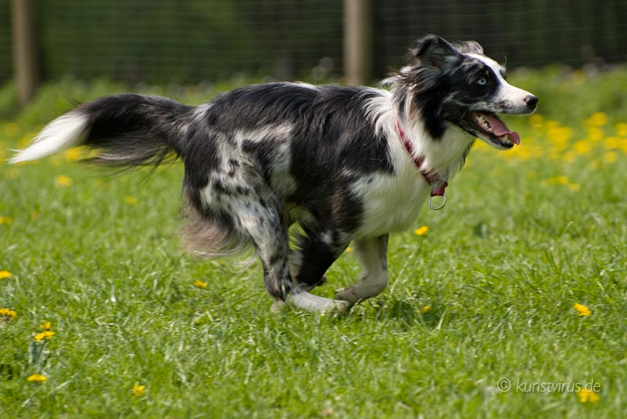
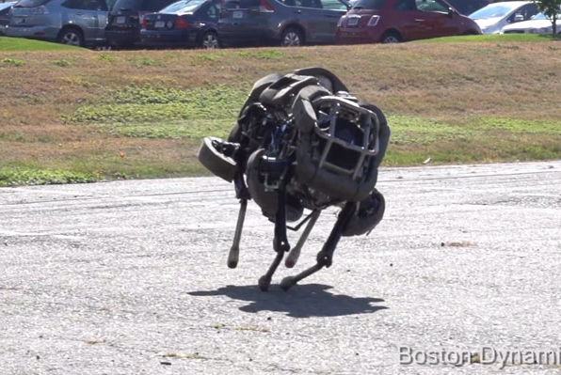
Introduction to locomotion
[B5]
[B6]
Mini Whegs
[B7]
[B8]
WildCat
Notes:
- jumping: wheeled-legs, winged-legs -> stretch spring
- running: boston dynamics, 26 km/h

Slide 6
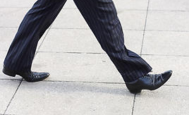
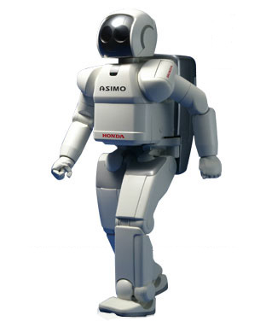
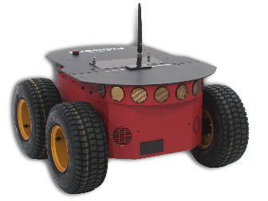
Introduction to locomotion
[B9]
[B10]
Asimo
?
[B11]
Pioneer
Notes:
-Walking: use human environments, sidewalk/stairs
-Wheeled: no known counterpart in nature, rolling polygon approximates walking

Slide 7
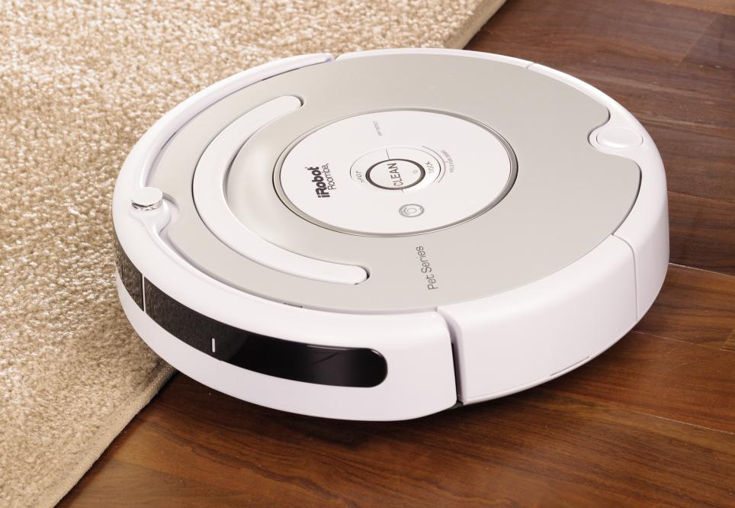
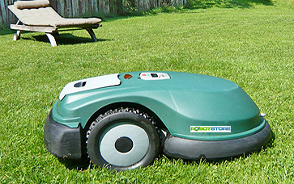
Why do we need mobile robots?
Do things which static robots can not do!
[B12]
[B13]
Notes:
-Robotic vacuum cleaner Roomba
-Autonomous mower robomaw
-Sell values -> comfort, safe time
-2012 3mio. robots

Slide 8
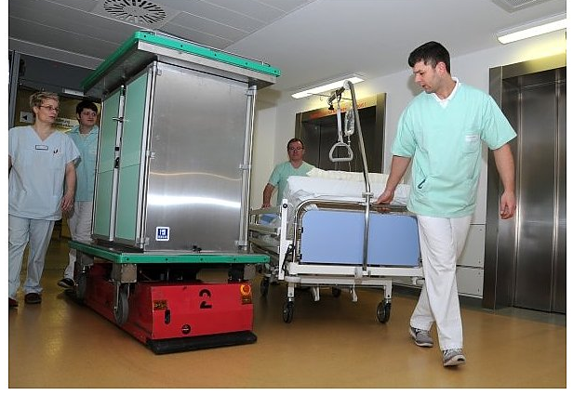
Where do we need them?
Daily life → e.g. home, medical facilities, nursing, entertainment
[B14]
Notes:
- Caesare

Slide 9
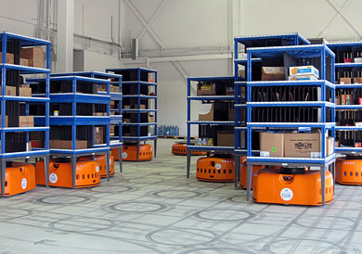
Where do we need them?
Industry → e.g. carry heavy loads, logistics
[B15]
Notes:
- kiva

Slide 10

Where do we need them?
Extreme environments → e.g. dangerous working places, disaster zones, war zones
[B16]
Notes:
- Curiosity

Slide 11
Core issues of locomotion (1)
Major trade-off
Statically-stable → center of gravity lies inside the support pattern
Stability
Maneuver-ability
Controll-ability
how “easy” the robot is to
control to achieve the desired motion
Number of manipulateable DOFs
Notes:
What is to do, to become statically-stable
How “easy” the robot is to control to achieve the desired motion
Amount of manipulateable DOFs

Slide 12
Core issues to locomotion (2)
Stability
Characteristics of contact
Type of environment
Velocity
Number and geometry of contact points
Angle of contact
Structure
Center of gravity
Friction
Medium
Energy efficiency
Static/dynamic stability
Inclination of terrain
Degrees of freedom

Slide 13
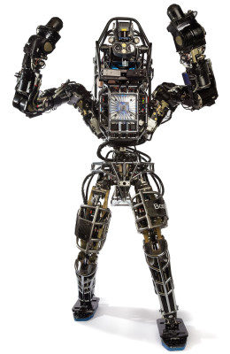
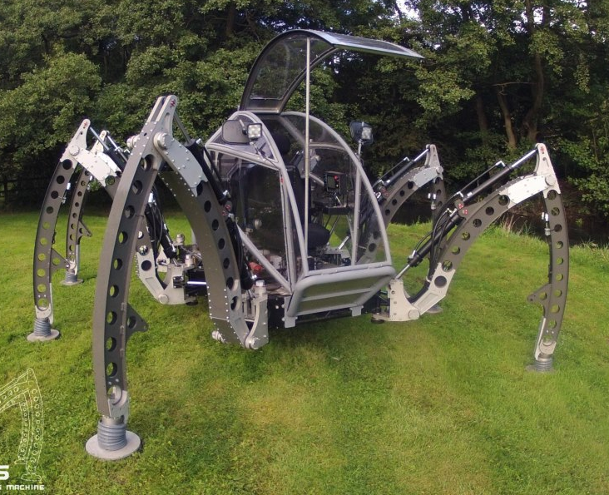
Legged Locomotion (1)
… series of point contacts between the robot and the ground
Quality of ground between point contacts do not matter
Properties:
→ Adaptability and maneuverability
in rough terrain
→ Potential to manipulate objects
in the environment
→ High power consumption and
mechanical complexity
Important issues:
→ Maneuverability vs. energy,
control and mass
→ Stability during walking
Atlas, bipedal robot, Boston Dynamics, 2013 [Q3]
Mantis hexapod walking machine, micromagic systems, 2009 [B17]

Slide 14
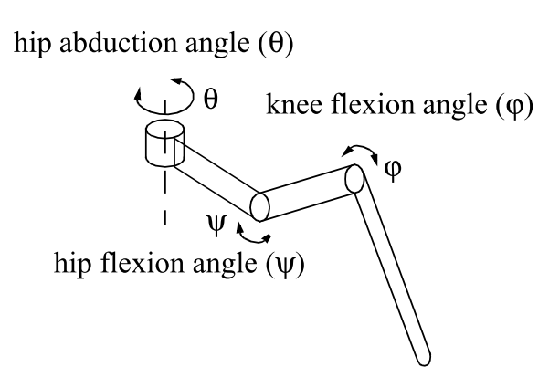
Legged Locomotion (2)
The leg
Adding joints = adding degrees of freedom (DOF)
Adding DOF =
→ increasing maneuverability
→ increasing power consumption and weight of the robot
→ controlling becomes more complex
Minimum of 2 DOF required for moving leg forward:
→ a lift and a swing motion
3 DOF for each leg in most cases
→ travel in rougher terrain
→ do more complex manoeuvres
Example of a leg with 3 DOF [Q1]

Slide 15
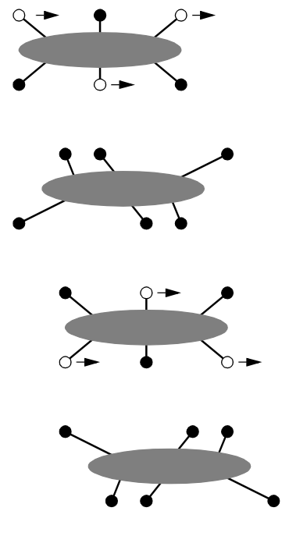
Legged Locomotion (3)
Stability during walking – static/dynamic stability
During walking some legs are lifted
–Thus loosing stability?
The fewer legs the more complicated becomes locomotion
→ At least 3 legs are required for static stability
Static walking requires at least 6 legs
→ more complex controlling,
→ higher weight,
→ higher power consumption
Bipedal robots are just dynamically stable
→ continuous balance-correcting is needed
Static walking with 6 legs [Q1]

Slide 16
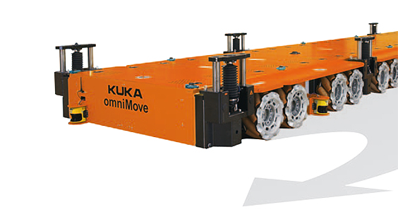
Wheeled locomotion (1)
Basic
Most appropiate solution for many applications
Most popular locomotion mechanism
Simple mechanical implementation
Easy balance
Very high efficiency ratings
Size of wheels can compensate
environmental constrains
[B18]

Slide 17
Wheeled locomotion (2)
Stability
3 wheels always stable
2 wheels can be stable
Environment
Biggest limitation → best on planar surfaces
Wheel size compensate environmental contrains
Velocity
Fastest movement
Energy efficiency
Wheels use simple mechanics → best e.e., but limited to planar surf.
Degrees of fredom
Omnidrive → 3DOFs
Need more, need special mechanisms

Slide 18
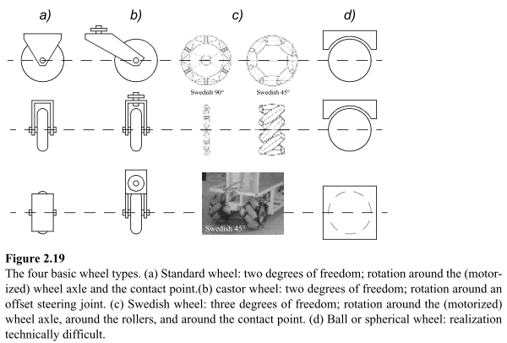
Wheel types and DOF
Standard wheel
2DOFs: Rotation around wheel axe (1) and contact point (2)
Castor wheel
2 DOFs: Roation around wheel axe (1)
and contact point (with offset)(2)
Swedish wheel
3 DOFs: Rotation around wheel axe (1), contact point (2)
and rollers (3) → omnidirectional
Ball / spherical wheel
difficult technical realization → omnidirectional

Slide 19
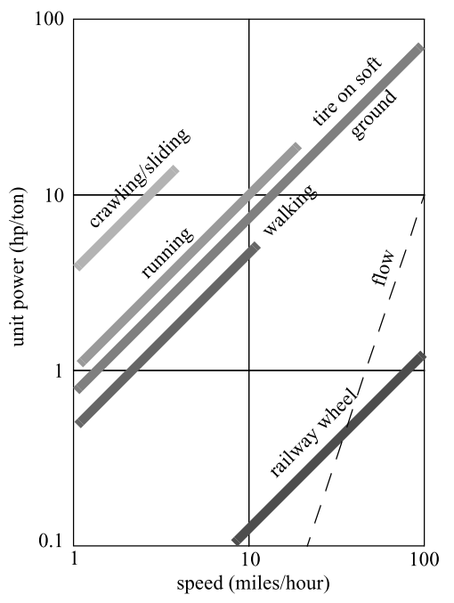
Comparision walking ↔ rolling
Core issue | Walking | Rolling
Stability | - | +
Environment | ++ | --
Velocity | - | ++
Energy efficiency | - | +
Degrees of freedom | + | -
At least 2 wheels can be stable (suspension)
Legs don´t be limited to environement
Wheels move faster (legs still on research)
Energy efficiency depends on reference
Legs can move upward (but complex)

Slide 20
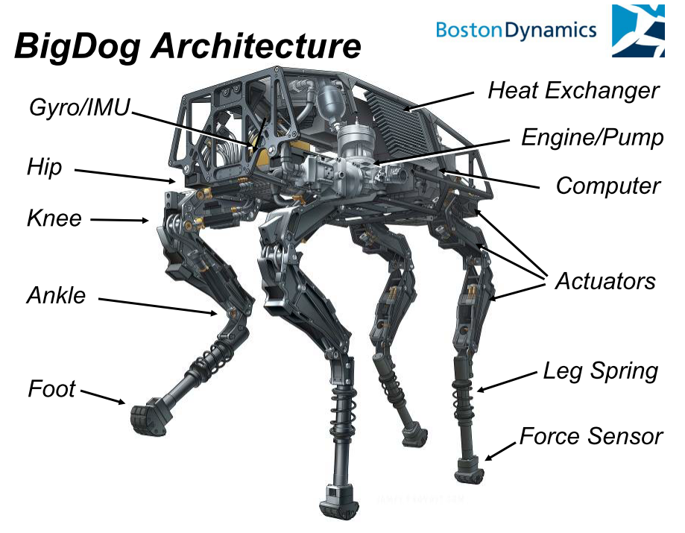
Outlook to locomotion: Walking Robots from Boston Dynamics
BigDog
Rough-terrain quadruped
robot
Runs at ~6.4km/h
[removed video]
Climbs slopes up to
35 degrees
Carries ~154kg
Funded by DARPA
[Q2]

Slide 21
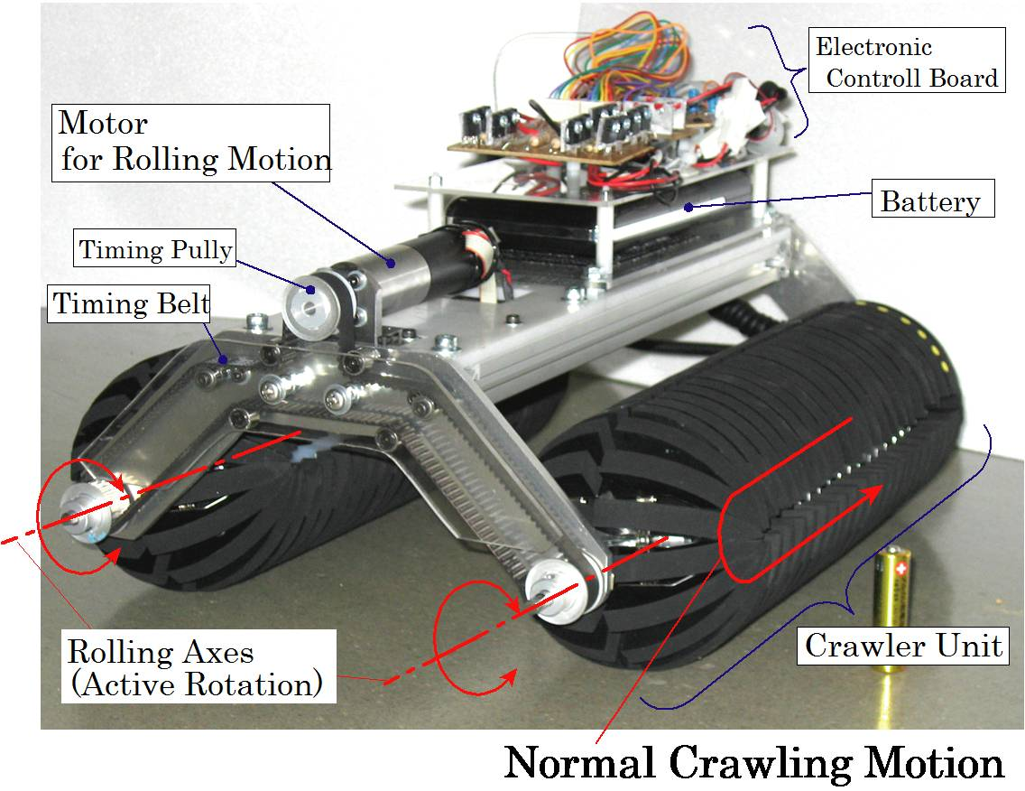
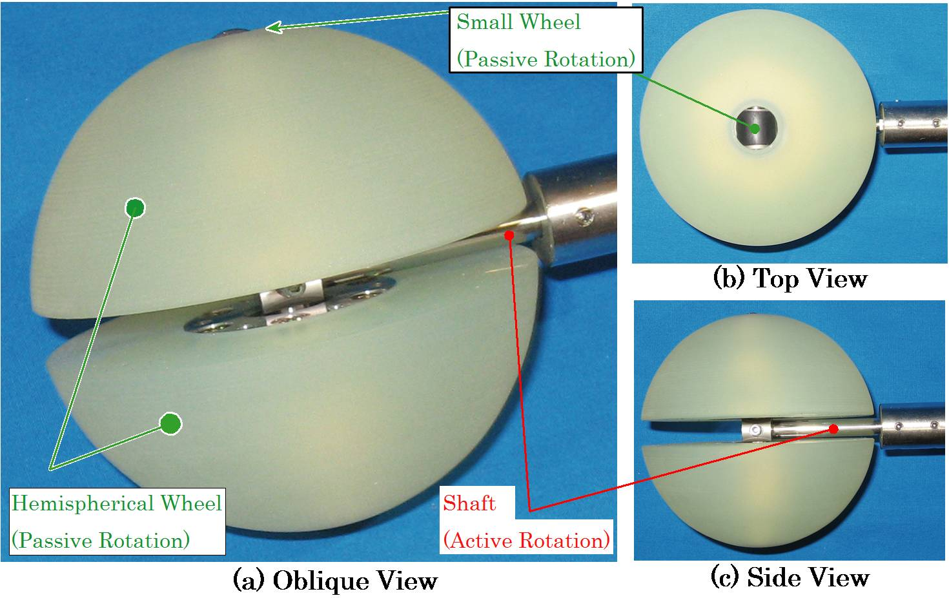
Outlook to locomotion: Omni-Crawler
From Osaka University (2009)
Active Omnidirectional movement
Crawler → big load capacities
[B19]

Slide 22
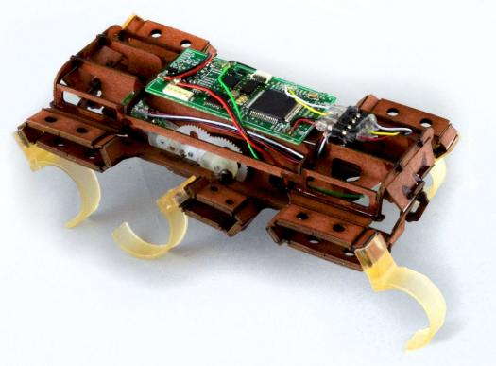
Outlook to locomotion: VelociRoACH
University of California, Berkeley (2013)
Closed kinematic chain
→ only one engine required!
Speed: 10km/h
Weight: 30g
Length: 10cm
→ 27 body length / sec
[B20]

Slide 23

Many thanks for your attention!

Slide 24
Sources
[Q1] Siegbart, Nourbakhsh: Introduction to Autonomous Mobile Robots. Massachusetts Institute of Technology, 2004.
[Q2] Marc Raibert, Kevin Blankespoor, Gabriel Nelson, Rob Playter
and the BigDog Team : BigDog, the Rough-Terrain Quaduped Robot.
Boston Dynamics, Waltham.
[Q3] http://www.bostondynamics.com Stand: 25.10.2013
[Q4] Martin Buehler: Dynamic Locomotion with One, Four and Six-Legged Robots. ARL, Centre for Intelligent Machines, McGill University Montreal.
[Q5] Fukuda, Hasegawa, Sekiyama, Aoyama: Multi-Locomotion Robotic Systems. 2012.
[Q6] Sven Böttcher: Principles of robot locomotion.
[Q7] K. Tadakuma, R. Tadakuma, Nagatani, Yoshida, Iagnemma: Crawler Mechanism with Circular Section to Realize a Sideling Motion. IEEE/RSJ 2008.
[Q8] Haldane, Peterson, Bermudaz, Fearing: Animal-inspired Design and Aerodynamic Stabilization of a Hexapedal Millirobot.

Slide 25
Image sources
[B1] http://upload.wikimedia.org/wikipedia/commons/f/fe
/Fierce_Snake-Oxyuranus_microlepidotus.jpg
[B2] http://biorob.epfl.ch/files/content/users/179700/files/private
/imports/importInto_ContentContainerList_469885_20110110155706.JPG
[B3] http://1.bp.blogspot.com/-R4EnpcDKpIE/Tvn3Qth8RvI/AAAAAAAACTQ/cXWhSaPwGQc/s1600/Raupe%2BSchwalbenschwanz.jpg
[B4] http://www.digitaltrends.com/wp-content/uploads/2012/08/meshworm.jpg
[B5] http://cdn.orkin.com/images/cockroaches/brown-cockroach-illustration_912x762.jpg
[B6] http://www.realclearscience.com/images/wysiwyg_images
/miniwhegs.png
[B7] http://www.australian-shepherd.kunstvirus.de
/fotos/aussietreffen/treffen0509/attend19.jpg
[B8] http://www.technocrazed.com/wp-content/uploads/2013/10/WildCat-Boston-Dynamics-Robot-Cat-gallops-at-26-Km-per-hr-2.jpg
[B9] http://p4.focus.de/img/gen/B/X/HBBX16Ja_Pxgen_r_300xA.jpg
[B10] http://www.diseno-art.com/images/asimo-walk.jpg
[B11] http://www.cyberbotics.com/dvd/common/doc/webots/guide
/png/pioneer3at_real.png

Slide 26
Image sources
[B12] http://3.bp.blogspot.com/-OmYtY35FJ2w/T_Yd2RxtFoI
/AAAAAAAAAQU/Ph-MTZCFZeM/s1600/iRobot-Roomba-532.jpg
[B13] http://www.eder-kommunal.de/export/sites/www.eder-kommunal.de/images/gartentechnik/robomow_garten.jpg
[B14] http://www.volksstimme.de/_em_daten/_cache/image/vsm
/0xUmFuZG9tSVYwMTIzNDU2N2PYf+iPAwGxSgUrvg0eJ0vaXlWreOoPI80Y2Y05M5xMmmpMwnOeDKdnP5sy3D9po7NgY4aLTXfT2g9kfKYo9Vla87QITqW6MqWjgEFySKum.jpg
[B15] http://www.hizook.com/files/users/3
/kiva_systems_robot_warehouse_2.jpg
[B16] http://upload.wikimedia.org/wikipedia/commons/d/d8
/NASA_Mars_Rover.jpg
[B17] http://hackedgadgets.com/wp-content/uploads/2013/03/Mantis-Hexapod-Walking-Machine-by-Matt-Denton-_6.jpg Stand: 25.10.2013
[B18] http://www.kuka-omnimove.com/NR/rdonlyres/722C49C4-7E16-4407-9319-703ED52D6F9A/0/H_KUKA_omniMove_03.jpg
Stand: 27.10.2013
[B19] http://assets.inhabitat.com/wp-content/blogs.dir/1/files/2013/01/VelociRoACH-UC-Berkeley-Biomimetic-Millisystems-Lab-Duncan-Haldane-Robot-Close.jpg
Stand: 25.10.2013
[B20] http://www-hh.mech.eng.osaka-u.ac.jp/robotics/Omni-Crawler_e.html Stand: 25.10.2013

Slide 27
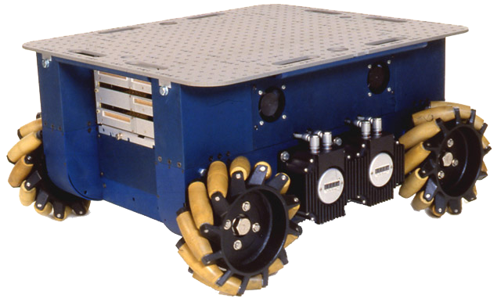
Appendix: swedish wheel
Omnidirectional, but passiv
4 engines needed
passive rollers

